Slide 1
Alabama’s New Implied Consent Law
and
Related DUI Topics
Patrick Mahaney
Montgomery, AL

Slide 2
Expungement
Expungement is NOT an option.
Revised expungement statute – Code 15-27-1 (b)(7) [eligibility requirements]: “The conviction is not a serious traffic offense, as provided in Article 9 of Chapter 5A of Title 32.”
Act 2021-482, which took effect on July 1, 2021, now allows for expungement of minor misdemeanor convictions not involving a crime of violence. However, specifically excluded from Act 2021-482 are DUI and reckless driving offenses.

Slide 3
What Is the ‘Implied Consent’ Law? …
And Where Did it Come From? A Short History of Autos, Alcohol and DUI Legislation in the USA:
1908 – Ford Model T placed into production; sells for $850 per unit
1911 – Alabama’s first DWI statute: “Whoever operates a motor vehicle while in an intoxicated condition shall be guilty of a misdemeanor.”
1920 – Over 7.5 million autos on U.S. highways
1919 – Eighteenth Amendment (prohibition) ratified
1920 - Federal law outlaws production, manufacture, and distribution of alcohol by Jan. 1920 but not the consumption of alcohol. Illicit alcohol production is widespread.
1924 – Ford Model T mass production assembly line drops unit price to $300
1929 – Over 23 million automobiles on U.S. highways; Chevrolet out-sells Ford for the first time in total auto sales in 1929.
1930 – Highway fatalities exceed 30,000 first time
1933 – 21st Amendment ratified; ends national prohibition

Slide 4
A Short History of Autos, Alcohol, and DUI Legislation in the USA:
1927 – Alabama’s first “Rules of Road” DWI statute: “It shall be unlawful for any person….who is under the influence of intoxicating liquor or narcotic drugs to drive any vehicle upon any highway within the state.”
1939 – State of Indiana enacts first 3-Tier DWI statute incorporating the Natl. Saf. Council & AMA recommended standards of .00-.05/.05-.15/.15+
1953 – New York enacts first Implied Consent Law
1954 – Robert Borkenstein invents and patents the “Breathalyzer”
  Breathalyzer updated with later models, including Models 900, 900A, 900B
  Between 1955 and 1999, more than 30,000 various Breathalyzer models produced and sold
  Used in nearly every U. S. state as well as all provinces of Canada and in Australia
1956 - National Interstate and Defense Highways Act creates the interstate highway system
1958 – Natl. Saf. Council and AMA recommend a .10% BAC presumptive standard; adopted in Uniform Vehicle Code of 1962.
1966 – National Highway Safety Act passed; NHTSA created.
1966 - MVA fatalities exceed 50,000 first time in U.S.

Slide 5
A Short History of Autos, Alcohol, and DUI Legislation in the USA:
1969 – State of Alabama enacts Implied Consent law and Chemical Test for Intoxication Act
  1969 version – “Any person who operates a motor vehicle upon a public highway of this State shall be deemed to have given his consent, … to a chemical test or tests of his blood, breath, or urine ..for the purpose if determining the alcoholic content of his blood if lawfully arrested…”
1971 – NHTSA recommends a national presumptive standard of .08% BAC
1971 – State of Alabama establishes state-wide breath testing program. Photo-electric Intoximeter placed into service. [Remains in service 1971-1985; replaced by Intoxilyzer 5000 in 1985]
1980 - Alabama legislature enacts new “Rules of the Road” legislation based on 1972 Uniform Vehicle Code. Chapter 5A of Title 32. The current DUI statute enacted Aug. 1980.
32-5A-191 (a): A person shall not drive or be in actual physical control of any vehicle while:
  (1) There is 0.08 percent or more by weight of alcohol in his or her blood;
  (2) Under the influence of alcohol;
  (3) Under the influence of a controlled substance to a degree which renders him or her incapable of safely driving;
  (4) Under the combined influence of alcohol and a controlled substance to a degree which renders him or her incapable of safely driving; or
  (5) Under the influence of any substance which impairs the mental or physical faculties of such person to a degree which renders him or her incapable of safely driving. [(a)(5) enacted in 1983]

Slide 6
A Short History of Autos, Alcohol, and DUI Legislation in the USA:
Highway MVA fatalities average 50,000+ every year in the decade 1969-1980 [except the “gas crisis” year of 1974/75]
1980 - Mothers Against Drunk Driving (MADD) founded as a public interest group in California. Relocates to DFW, Tx in 1985.
1985 - Pres. Reagan hosts White House conference on ‘drunk driving’; the “20/20 plan” issued shortly thereafter.
1995 - Alabama legislature re-writes the DUI statute lowering the per se violation from .10% to .08%; incorporated the same changes into the chemical test act.
1996 – Alabama enacts “administrative license suspension” statute with terms of construction tied to the existing Implied Consent Law.
2013 – NHTSA formally recommends to Congress to adopt a national .05% BAC standard

Slide 7
Autos and Fatal Motor Vehicle Accidents
1940 -2020
1941-45 – WWII. Civilian auto production halts; does not resume until 1947-48. Fatal accident rate drops 1942-1946. [MVA deaths per 100,000 in brackets]
1950 – Over 25 million registered vehicles; 33,000 fatal MVA [21.79]
1960 – Over 67 million registered vehicles; 36,000 fatal MVA [20.15]
1970 – Over 118 million registered vehicles; 52,000 fatal MVA [25.67]
1980 – Over 150 million registered vehicles; 51,000 fatal MVA [22.48]
1990 – Over 190 million registered vehicles; 45,000 fatal MVA [17.88]
2020 – Over 276 million registered vehicles; 38,000 fatal MVA [11.67]
2022 – Over 289 million registered vehicles; 42,000 fatal MVA [TBD]

Slide 8
Two Major Changes from DWI to DUI
The first major change contained in the 1980 DUI statute was the removal of the term “intoxication” as part of the of the offense.
Under the 1980 statute, a new term replaced “driving while intoxicated” with “driving under the influence.”
The second major change that took effect with the enactment of the 1980 statute was, for the first time in this state, a per se violation of the DUI statute based strictly on the blood or breath test reading.
No evidence of actual physical impairment or proof of intoxication is required to obtain and uphold a conviction.

Slide 9
DUI becomes a ‘blood-alcohol’ offense
The per se violation constituted a major shift in the prosecution of the DUI driver.
Testimony now centered on test admissibility rather than the indications of physical impairment of the motorist.
Additionally, with two later pieces of legislation, the state’s case was easier to prove than previously:
  Act 660 of the 1988 legislature re-wrote the chemical test for intoxication act, and included as part of the statute the “2100 to 1 ratio” as a fundamental part of state law governing the administration of breath tests.
  In 1995, the legislature re-wrote the DUI statute lowering the per se violation from .10% to .08%, and incorporated the same changes into the chemical test act.

Slide 10
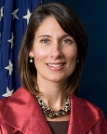
On the Horizon – the NATIONAL .05% Standard
May 2013 – National Transportation Safety Board “recommended” all states adopt a per se blood alcohol concentration (BAC) limit of .05% for all drivers.
"Most Americans think that we've solved the problem of impaired driving, but in fact, it's still a national epidemic," said NTSB Chairman Deborah A.P. Hersman. "On average, every hour one person is killed and 20 more are injured.”
[Factoid: Hersman was chair of NTSB 2009-2014. Salary as Executive Schedule II in 2014 - $178,700. Moved to Chairman and CEO of National Safety Council in 2014. Salary and benefits in 2019 - $718,046.
She stepped down at the National Safety Council in January 2019 to lead the safety team at Waymo. Waymo LLC, formerly known as the Google self-driving car project.]

Slide 11
Is There a Statistical Basis for the .05% Standard?
1938 – The “Evanston” study by Harger and Heise: Accident rate increases geometrically with each .02 g/dL in the blood
1938 - National Safety Council and American Medical Assn. recommend statutory level of intoxication of less than .05% presumed not intoxicated; greater than .15% presumed intoxicated; and between .05% and .15% “supportive evidence” of driving under the influence.
1958 – National Safety Council and AMA recommend that all states adopt a uniform standard of .10% BAC as “presumptive evidence” of intoxicated driving.
1962 – Uniform Vehicle Code amended to reflect the three tiers: .05% presumed not intoxicated; .06% to .09% no presumption; and .10% as “presumptive” of intoxication.
1964 – the “Grand Rapids” study by Borkenstein: Drivers with .00 to .04% BAC had no statistical difference in risk of accident; with a .06% BAC 2X risk of accident; with a .10% BAC 6X risk of accident; and .15% BAC 25X risk of accident.

Slide 12
On the horizon….a ‘National’ DUI/DWI Statute
Future (probable) state DUI statutes drafted by NHTSA:
  Two types of DUI offenses: a per se alcohol violation with .05% as the statutory limit for alcohol and a “any substance” offense for all other DUI/DWI offenses.
  Complete revision of the state’s Chemical Test for Intoxication Act amending the current three tier level .00-.05/.06-.07/.08 or greater to a single level of .05% or greater presumed operating under the influence and no presumption for less than .05%.

Slide 13
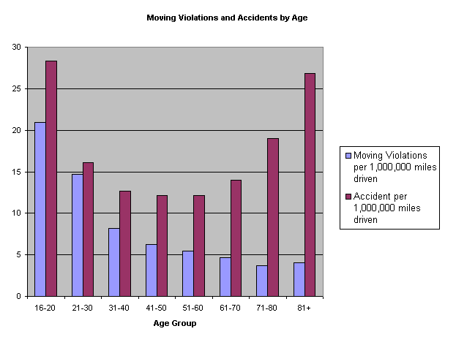
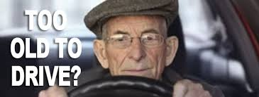

The Most Dangerous Driver on the Road?
The Over 80 driver!!

Slide 14
What is the Implied Consent Law vs. What is the DUI Statute?
DUI Statute: Proscribes and defines the elements of the criminal offense of operating a vehicle in an intoxicated or impaired condition and provides penalties and sanctions to enforce such statute. Construction and application of such statute are defined by terms of criminal law.
Implied Consent Law: Establishes as part of the state traffic code any person who operates a motor vehicle upon the public highways of the state is deemed to have given their consent to submit to a chemical test to determine the alcoholic content of their blood.[Subsequently expanded to include substances in addition to alcohol.] Sanctions are civil/administrative in nature and the law’s application is construed under civil law standards.
Shorthand version: The Implied Consent law is the procedural mechanism to enforce the substantive DUI statute.

Slide 15
Act 2021 – 498
Key Provisions - Implied Consent Statute
Amends current Implied Consent statute [Code 32-5-192] from alcohol only to “any impairing substance or substances within a person’s system.”
Removes urine from testing and replaces with “oral fluid” – a new concept in Alabama law enforcement.
Authorizes multiple tests (blood, breath, & oral fluid) at direction of the arresting officer.
Authorizes use of “court order” to obtain test samples if the arrested subject refuses to consent to testing.
Expands Implied Consent refusal from alcohol only to “alcohol or any impairing substance.”

Slide 16
Act 2021 – 498
Amends 32-5A-194 [Chemical Test for Intoxication Act]:
a) Chemical analysis of blood, breath, and oral fluids shall be undertaken by regulations established by Alabama Department of Forensic Science; courts shall take judicial notice of those standards.
b) Authorizes any paramedic to draw blood* [*currently prohibited by State Board of Health regulations unless under the direct supervision of a medical care provider and only for life support functions]
c) Provides complete civil and criminal immunity to any M.D., R.N., or paramedic or other person, to include any fire department, rescue squad, private ambulance service, or hospital that undertakes a blood draw at the direction of a law enforcement officer.

Slide 17
Act 2021 – 498
Additional Changes
Amends 32-5-200 [Implied Consent Act for Motor Vehicle Accidents with Serious Injuries/Death] from alcohol and three listed analytes to alcohol and “any other impairing substance.”
Retains two (2) year license suspension for test refusal if arrested under this statute [as compared to 90 day suspension for test refusal under Code section 32-5-192]

Slide 18
Act 2021 – 498
Additional Changes
Amends 32-6-49.13 [CDL variant of DUI] removes urine as an analyte and replaces with oral fluid testing; retains the 0.04% BAC for alcohol.
Greatly changes admissibility of DUI trial evidence: Legislatively over-rules prior Alabama judicial decisions and by legislation admits Horizontal Gaze Nystagmus in a judicial proceeding as a probable cause field test.

Slide 19
HGN Admissibility
Act 2021-498, section 3: “Notwithstanding any other provision of law and for purposes of prosecutions under Section 32-5A-191, a law enforcement officer witness may give testimony solely on the issue of impairment, and not on the specific alcohol or drug concentration levels, based on the results of a horizontal gaze nystagmus test….”
  Does not require APOSTC certification or re-certification in administration of HGN
  Is limited to prosecutions for DUI [Code section 32-5A-191]
  Does not address the Frye/Daubert distinction in Ala. Rules of Evidence, Rule 702

Slide 20
Act 2021 – 387
Amends 32-5-192(c)
Increases the Implied Consent lookback period from 5 years to
10 years.
Increased suspension durations for third and fourth refusals within 10 year period.
(new) third refusal suspended for 3 years
(new) fourth or subsequent refusal suspended for 5 years
CAVEAT: No interlock ignition installation available for implied consent refusals!

Slide 21
What is NOT Changed
Administrative License Suspension Statute [Code section 32-5A-300] remains intact with the .08% breath test requirement or test refusal as a “civil/administrative violation”. [Note: July 7, 2022 revision to AST-60 incorporates “oral fluid” into test refusal.]
Breath testing standards and test protocol remain the same; DFS regulations continue in place.
The substantive DUI statute [Code section 32-5A-191] remains in place and untouched - same elements of proof, same sanctions, same penalties.
The term “impairing substance” is never defined in any part of Act 2021 - 498; there are no presumptive levels of impairment (except alcohol at .08% BAC); there is no legislative guidance to the word “impaired” – the presence of a controlled substance in a blood analysis does not, in itself, equate to “impairment.”

Slide 22
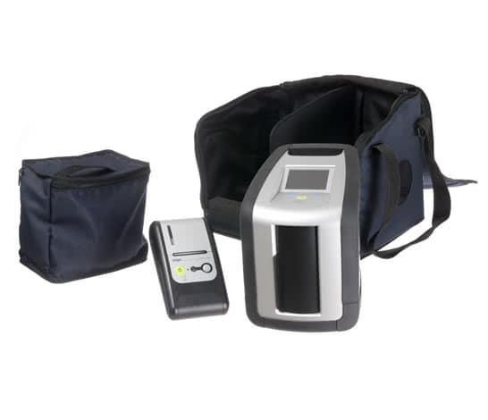
Dräger DrugTest® 5000

Slide 23
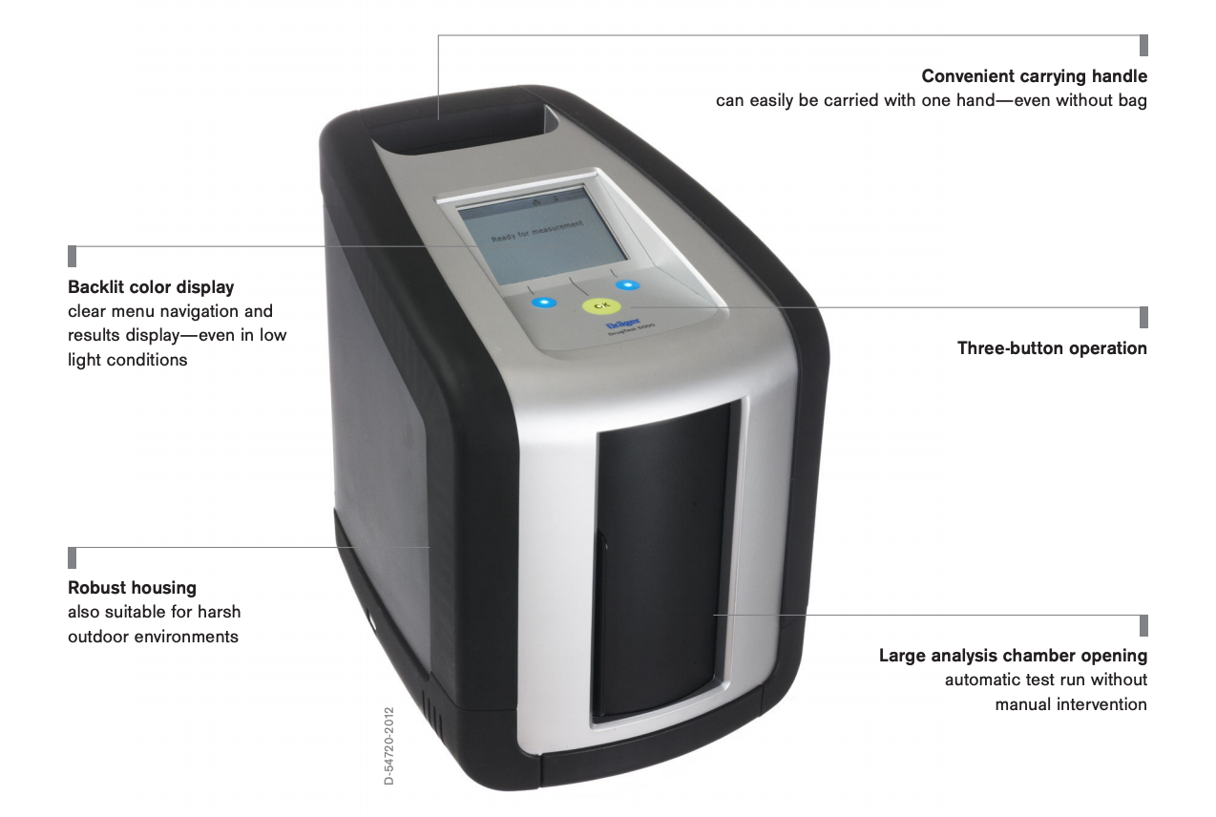
New Oral Fluids Testing Device
Dräger DrugTest® 5000

Slide 24
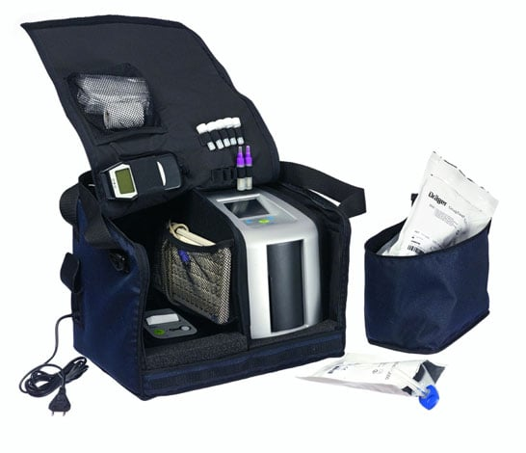
Dräger DrugTest® 5000

Slide 25
Draeger 7 Panel Cut-Off Levels
AMP (D-Amphetamine) 50 ng/mL
MAMP (D-methamphetamine) 35ng/mL (MDMA 75)
COC (Cocaine) 20 ng/mL
OPI (Morphine) 20 ng/mL
THC (D9-tetrahydrocannabinol) 5 ng/mL
BENZO (Diazepam) 15 ng/mL
MTD (Methadone) 20 ng/mL

Slide 26
Does a ‘Positive’ Result on the Draeger 5000EN Equate to Impairment?
“It is important to note that there is not a direct correlation between concentration and the degree of impairment for drugs other than alcohol with any specimen type and it is ill-advised to predict impairment in a specific individual based on toxicology results alone.”
  Use of Oral Fluid to Detect Drugged Drivers: A Toolkit (2022) [Pg. 8]

Slide 27
The Blood Test Checklist
Forcible extraction or taken by consent?
  Was the consent truly voluntary or a product of unlawful coercion?
Code section 32-5-192, the Alabama Implied Consent statute, expressly states that if the motorist refuses a blood test, “none shall be given” unless “a court order has been obtained ordering such person to submit to a chemical test or tests.” [Code section 32-5-192 (c)(1) eff. Aug. 1, 2021]
  Forcible extraction must comply with U.S. Sup. Ct. requirement of Missouri v. McNeely and Ala. Rules of Criminal Procedure, Rules 3.6, 3.10, 3.11, and 3.12.
  “Reasonable force” may be used to gain sample if the subject refuses.
  DFS blood test results are not self-proving and require a full evidentiary predicate for admissibility

Slide 28
The competent trial lawyer will examine the following (credentials):
Validity of the search warrant to seize a blood sample and the Fourth Amendment requirement of probable cause that evidence of a crime will be found at the execution of the search warrant.
  [Motorist's refusal to consent to a blood draw does not, by itself, establish that any alcohol or controlled substances will be found; there must be facts and circumstances that would indicate the basis of such belief in the affidavit.]
Does the search warrant meet all the Ala. Rules Crim. Proc. warrant requirements?
  Name of affiant, name of issuing judge, court of jurisdiction, date/time executed.
  If S.W. obtained by telephone, was a verbatim recording made?
The arresting officer's credentials – special problems when dealing with municipal officers:
  APOSTC certified within 6 months of hire [Code section 36-21-46(a)(3)]
  Making the arrest within his/her jurisdiction [generally, the police jurisdiction of the municipality]
  Does the municipal officer hold an oath of office issued by the mayor and signed by the municipal clerk? [Code section 11-44E-185.]
  Also, check the credentials of the phlebotomist - must hold a valid license issue by the state Board of Health. A licensed R.N. or M.D. is presumed qualified. [Code section 32-5A-194(a)(2)]

Slide 29
The competent trial lawyer will examine the following (technique):
What was the method of cleaning site preparation?
  An alcohol-based prep pad or a non-alcoholic cleaner?
What was the method of taking? It should fill 10 mL grey stopper blood tube (with a 10% +/-variance allowed).
  How do you know? Who checked the fill line?
The manner of taking, custody and storage of the blood vials (2).
  Did the blood vials (2) contain the proper preservative? [100 mg sodium fluoride and 20 mg potassium oxalate]. How do you know? Who checked?
Storage temperature - should not exceed 4 deg. C [39 degrees F.], but not below 0 C /32F.
  Unrefrigerated blood vial can cause auto-genesis of ethanol in the tube!
  Frozen blood - blood is about 92% water - may cause cell rupture (hemolysis), and potentially result in a higher BAC.
Was the result a "hospital" blood test - an enzymatic test run at the hospital lab using the enzymatic testing method, or whole blood, as required by statute, and tested by chromatography?
"Hospital" blood tests are always 14%-16% higher in alcohol content due to the use of serum instead of whole blood.

Slide 30
The competent trial lawyer will examine the following (results):
Who took custody of the vials? What is the chain of custody? Where were the vials placed prior to and during transport to DFS? In what condition were the vials rec'd at DFS and when?
The DFS report/result by itself is not a "business records” exception but hearsay.
  See, Bullcoming v. New Mexico, 564 U.S. 647 (2011) - both the lab tech who drew the blood and the analyst who ran the chromatography test are subject to cross-examination under the confrontation clause.
Does the chromatograms to show the forensic analysis [result]?
  Not the one-page "summary" of a DFS report, but the entire chromatogram. 20+ pages showing full analytical steps with calibrators, blanks, plots and peak values.
Who examined the charts and signed off as the DFS lab supervisor?
Was the second vial retained in cold storage for independent testing by the defendant? [Ala. Code 32-5A-194(3)]

Slide 31
What Does Act 2021-498 Mean to the Criminal Defense Lawyer?
The Lawyer must understand the scientific principles of chromatography to include how to correctly read the chromatograms.
  GC – FID
  GC – MS
  LC – MS-MS
The Lawyer must understand blood test evidence, to include the blood draw technique, the correct preservative, custody and control, correct storage, and forensic analysis by chromatography.
The Lawyer must be prepared to challenge search warrants based on flimsy or even non-existent probable cause and especially the 3:00 a.m. search warrant issued via telephone!

Slide 32
The Bottom Line
The new Implied Consent law is a gold mine of opportunity for the prepared lawyer..... preparation is the KEY....
Standardized Field Sobriety Battery course (2 days)
Mastering Scientific Evidence (MSE) – National College for DUI Defense – held annually N.O., LA
Chromatography training courses – Axion Labs, Chicago, IL [https://forensicchromatography.com/]
People – potential clients - are not going to stop drinking alcohol and/or use controlled substances and will not stop driving impaired, whether alcohol, controlled substances, or a combination of alcohol and controlled substances. Your job is to provide an effective defense!

Slide 33
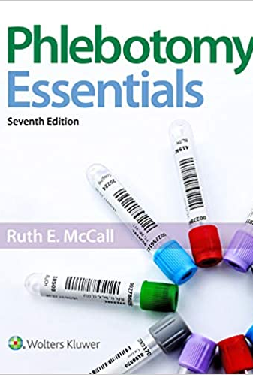
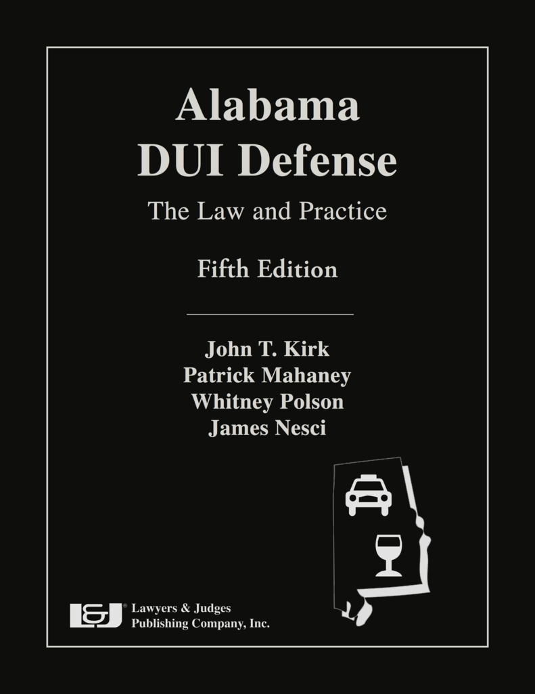
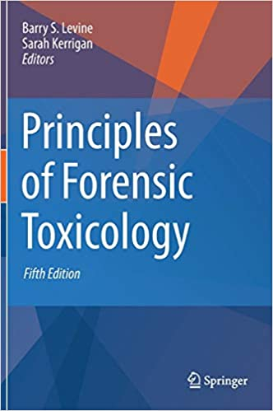
Essential Tools for Your Practice!

Slide 34
The Bottom Line
Clients will pay top $$$ for a good defense attorney. The sanctions for any DUI conviction are severe and will get more severe.
Alcohol will always stay around as the primary and most frequently encountered impairing substance (and NHTSA is pushing Congress to lower the presumptive level to .05%), but DUI trial evidence is now supplemented by use of pharmaceuticals and illicit substances.
The new oral fluid testing and anticipated much greater use of blood draws (and resulting search warrant battles) will only enhance your DUI client base.
Are you ready?

