Slide 1
Ignition Interlock and Breath Testing
Patrick Mahaney
Montgomery, Alabama

Slide 2
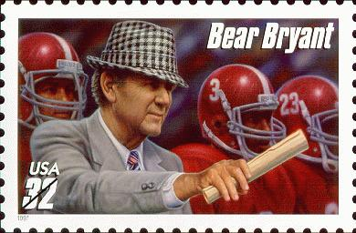
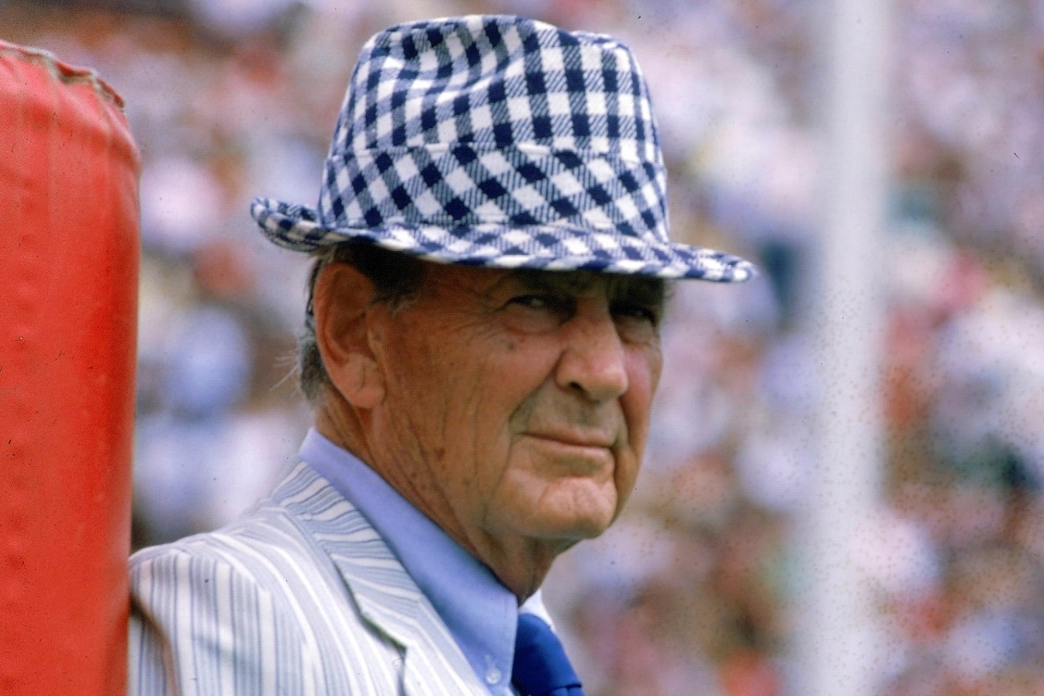
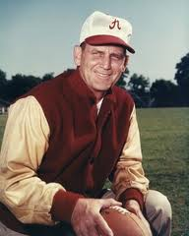
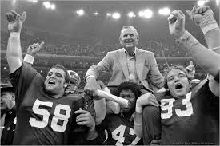
“Gentlemen, This is a Football”

Slide 3
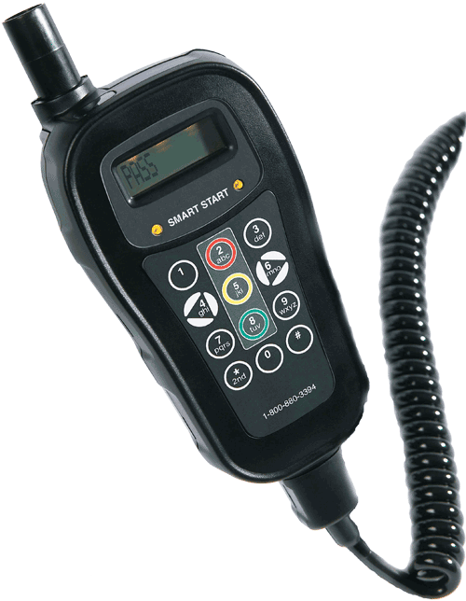
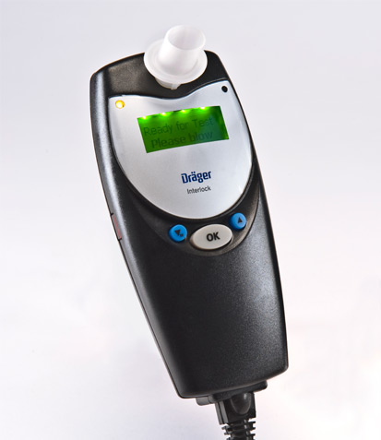
Gentlemen, This is an Ignition Interlock!

Slide 4
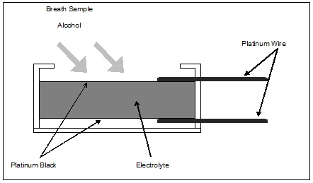
Fuel Cell Schematic

Slide 5
Warning! Interlock Fuel Cell Detects ‘Alcohol’ But Is Not ‘Ethanol’ Specific!
Alcohol: An organic compound in which a hydroxyl group (O-H) is bonded to a carbon atom which in turn is bound to other hydrogen and/or carbon atoms.
Common alcohols:
  Methyl alcohol “Methanol” CH3OH
  Ethyl alcohol “Ethanol” CH3CH2OH
  n-Propyl “1-Propanol” CH3CH2CH2OH
  Isopropyl alcohol “2-Propanol” (CH3)2CHOH
  n-Butyl alcohol “1-Butanol” CH3(CH2)CH2OH

Slide 6
Some Common Alcohols
Common Name | Physical Description | USES | LETHAL DOSE
Methanol (Wood alcohol) | CH₃OH | Denaturant, solvent, fuel, paint remover | Approximately 0.07 gms/dl
Ethanol (Grain alcohol) | CH₃CH₂OH | Beverage, solvent, medicinal vehicle, fuel | Approximately 0.45 gms/dl
Isopropanol (Rubbing alcohol) | CH₃CHOHCH₃ | Denaturant, solvent, disinfectant | Approximately 0.25 gms/dl

Slide 7
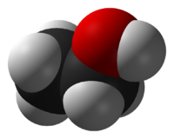
Oxygen Carbon Hydrogen

Slide 8
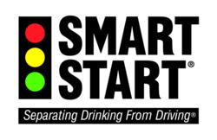
….and the Primary Beneficiary of the 2018 Revised DUI Bill?
The Interlock Industry!
Total arrests: 10,000 (avg. yr.)
Total new interlocks required: 9,000 per year
Duration of interlock: 6 mo. to 2 years
At full implementation - number of interlocks required each year: 18,000 units
Estimated yearly retail value: $19.8 million (at an estimated avg. cost per vehicle: $1100 per year)

Slide 9

Mothers Against Drunk Driving
November 2006 press release, MADD launched its 'Campaign to Eliminate Drunk Driving’
This was labeled as a four-point plan to completely eliminate drunk driving in the United States using a combination of current technology (ignition interlock devices), new technology in smart cars, law enforcement programs, and grass roots activism.

Slide 10
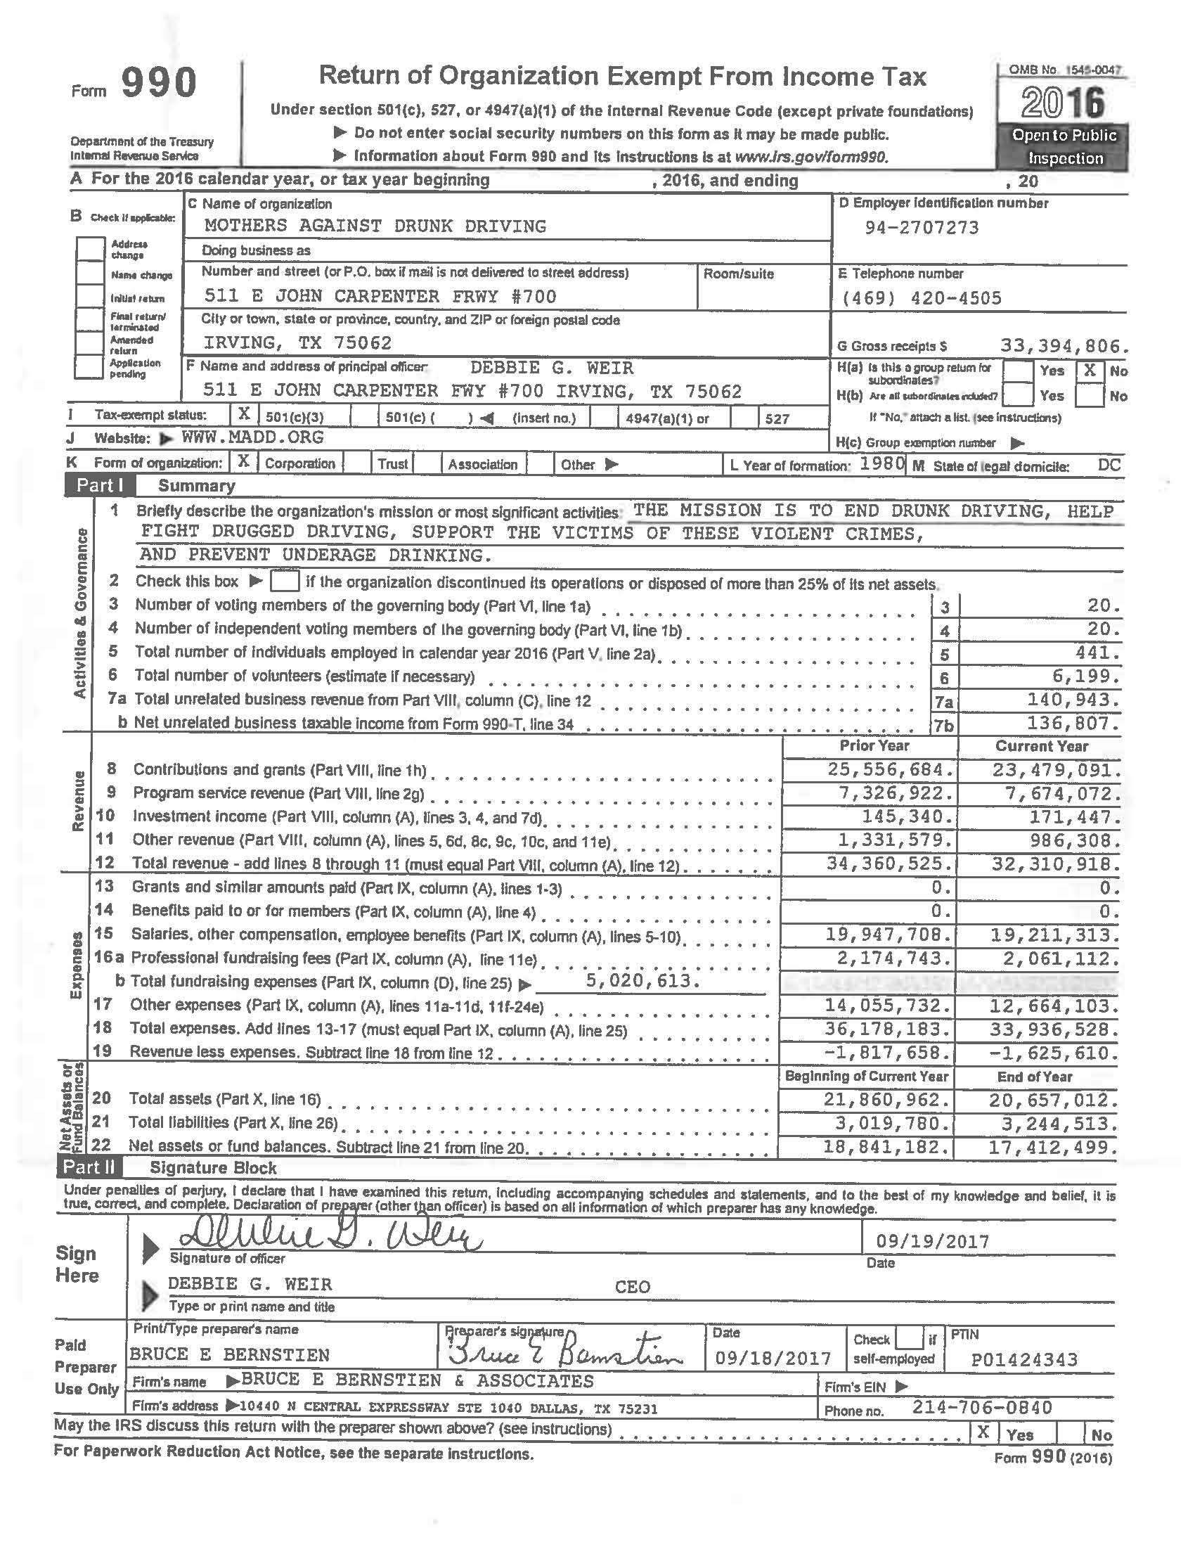
MADD’s 2016 Federal Tax Return

Slide 11



MADD and SmartStart Revenues
MADD Salaries and Revenue During 2016
As Reported on IRS Form 990 (9/18/2017)
SmartStart Revenue
Debbie Weir, COO/CEO
In 2016, Ms. Weir was paid a salary of $251,464.00 PLUS $27,349.00 in other income from MADD .
Lista Hightower, CFO
In 2016, Ms. Hightower was paid a salary of $216,752.00 PLUS $17,838.00 in other income from MADD.
2016 MADD Gross Revenue: $33,394,806.00
$23,439,000 in “contributions” from private, non-governmental sources.
$19,211,313 in staff salaries (57% of income)
SmartStart USA estimated annual revenue: $6,400,000.00
Note: SmartStart is organized into individual, self-reporting corporations in each state where service locations are provided; i.e., SmartStart Alabama, SmartStart Louisiana, etc.

Slide 12
The Interlock Trifecta
1. Draeger Safety Diagnostics Inc.
4040 W. Royal Lane Suite 136
  Irving, TX 75063
2. Smart Start Corporate Office
500 E. Dallas Rd.
Grapevine, TX 76051
3. MADD National Office
511 E. John Carpenter Freeway Suite 700
Irving, TX 75062

Slide 13
SmartStart
500 E. Dallas Road
Grapevine, TX 76051
Devices: SSI 20/20 and SSI 20/30
Website: http://www.smartstartinc.com/
Service Contact: 1-800-880-3394

Slide 14
Draeger Safety Diagnostics
4040 W. Royal Lane, Ste. 136
Irving, TX 75063
Device: Draeger Interlock XT
Website: http://www.dsdi4life.com/interlock-xt/
Service Contact: 1-866-385-5900

Slide 15
DUI arrest and conviction rate continues downward: State population increased 20% over the past 30 years, but DUI arrests declined by more than 50% during the same period.

Slide 16
DUI Arrests Continue to Decline
DUI arrests drop to record low: DUI arrest and conviction rate continues downward. State population increased 20% over the past 30 years, but DUI arrests declined by more than 75% during since 1980. [Source: Alabama Law Enforcement Agency, Public Information Unit, June 2018]
Total reported DUI arrests in 2015 were 10,488 resulting in 6,943 convictions (66%).
Total reported DUI arrests in 2016 were 8,599 resulting 5,934 convictions (69%)
Incomplete total DUI arrests in 2017 were 5,836 resulting in 4,452 convictions (76%)
The sharpest drop in state-wide DUI arrest rate occurred during the past six years when total DUI arrests in 2010 were reported as 20,570 versus the 2016 arrest total of 8,599, or 11,971 fewer arrests!
The 2016 arrest rate is more than a 75% decrease in total DUI/DWI arrests since 1980.

Slide 17
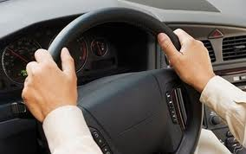
Interlock’s Greatest Threat – the Transdermal Steering Wheel!

Slide 18
The Transdermal Steering Wheel
Sober Steering Sensors Inc. founded in Florida in 2008
How it works:
  Driver places key in ignition and turns to “on” position
  Places an ungloved hand on the sensor pad for three (3) seconds
  If alcohol is detected, vehicle cannot start
  911 call sent to police and EMS to alert of potential “drunk driver” [device can be connected to vehicle’s ‘On-Star’ GPS vehicle locator to track vehicle’s movement]
  If no alcohol is detected – vehicle can start
  Device requires irregular and random timed “re-tests” during vehicle operation

Slide 19

On the Horizon – the .05% Standard
May 2013 – National Transportation Safety Board “recommended” all states adopt a per se blood alcohol concentration (BAC) limit of .05% for all drivers.
"Most Americans think that we've solved the problem of impaired driving, but in fact, it's still a national epidemic," said NTSB Chairman Deborah A.P. Hersman in a statement. "On average, every hour one person is killed and 20 more are injured."

Slide 20
On the horizon….a ‘National’ DUI/DWI Statute
Future (probable) state DUI statutes:
  Two types of DUI offenses: a per se alcohol violation with .05% as the statutory limit for alcohol and a “any substance” offense for all other DUI/DWI offenses.
  Complete revision of the state’s Chemical Test for Intoxication Act amending the current three tier level .00-.05/.06-.07/.08 or greater to a single level of .05% or greater presumed operating under the influence and no presumption for less than .05%.

Slide 21
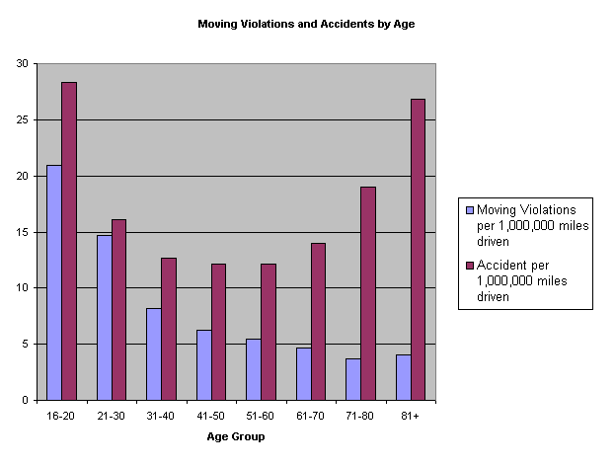
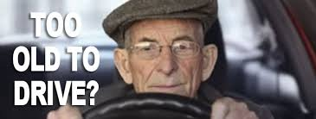
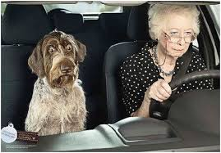
The Most Dangerous Driver on the Road? The Over 80 driver!!

Slide 22
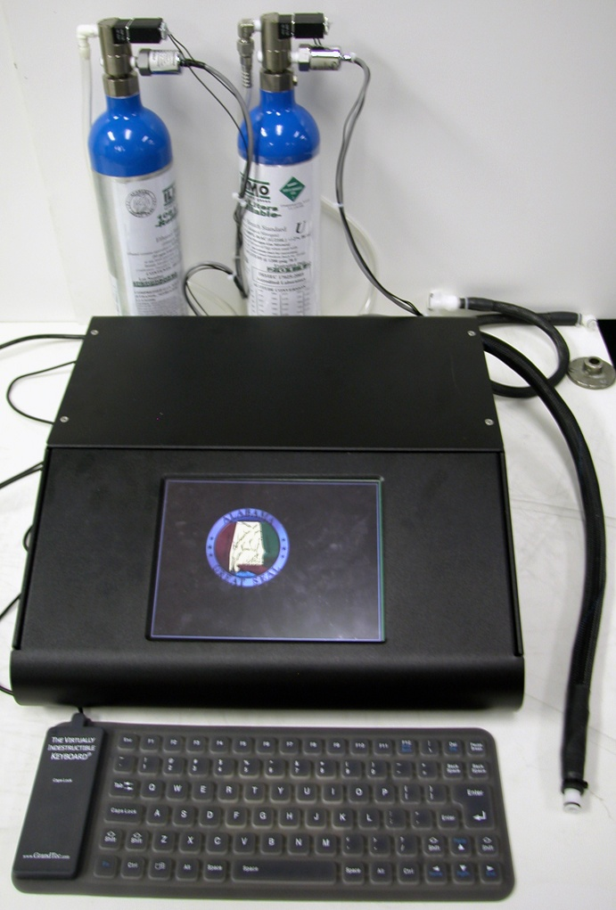
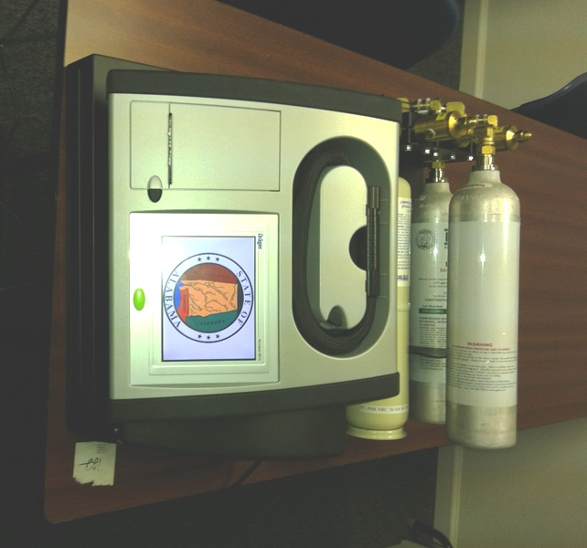
New Instrumentation

Slide 23
Draeger 9510
Successor instrument to the current 7110
IR 9.5 µ and Electrochemical Fuel Cell (Quantifies both)
Breath Temperature correction to 34°C
0.020 / 0.080 and 0.15/210L calibration checks (Dry Gas)
Continuous diagnostics
Capable of printing breath curves at the time of the test

Slide 24
Intoximeter DMT-F
Dry gas capable
  Two connections for dry gases
  Pressure monitored using pressure transducer directly connected to the gas cylinder
IR @ 3.445µ, 3.373µ , and 3.501µ [Three filters]
  Electrochemical Cell
    Result from fuel cell compared to the IR results and must agree within 0.008 g/210L up to 0.100 g/210L and 8% at higher alcohol concentrations

Slide 25
Draeger 9510 vs Intoximeter DMT-F
Draeger 9510: Dual sensor analytic testing using IR spectroscopy at 9.5µ (no filter) and a Draeger fuel cell
Intoximeter DMT-F: Dual sensor analytic testing using IR spectroscopy at 3.44/3.37/3.50µ (three filters) and a Intoximeter fuel cell
Optical bench: Intoximeter DMT-F uses a 1.1 meter light path with three bends 50 cc light chamber while Draeger uses a 70 cc light chamber with 11 reflections

Slide 26
The Winner: Intoximeter Inc. ‘Dual Analytical’ Instrument
Current test protocol of two tests, taken at least two (2) minutes and not more than fifteen (15) minutes apart is retained.
Current test parameters of each sample 1.3L of expired air/12L per minute flow rate/4 seconds of exhalation retained.
Dry gas cal check on every test at .02% and .08% retained, but a third cal check at .15% added if the subject’s test result is 0.15% or greater.

Slide 27
What Are We Looking For?
Ethanol – Not “Alcohol”

Slide 28
Ethanol (Ethyl Alcohol)
Definition: Ethyl alcohol is an organic compound containing carbon, hydrogen, and oxygen atoms.

Slide 29
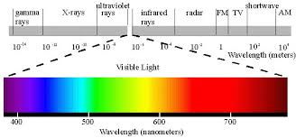
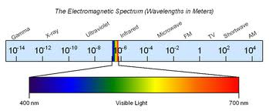
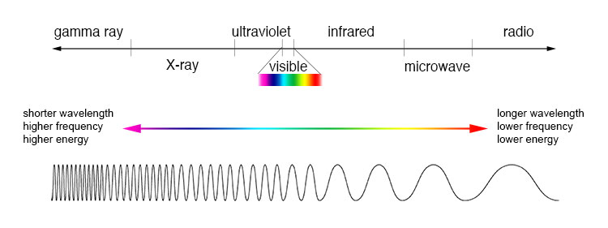
The electromagnetic spectrum

Slide 30
Infrared Spectroscopy
Infrared Spectroscopy is the analysis of infrared light interacting with a molecule. This can be analyzed in three ways by measuring absorption, emission and reflection. [Infrared light is radiant energy whose wavelengths fall just after the red end of the visible light spectrum.]
IR Spectroscopy measures the vibrations of atoms, and based on this phenomena, it is possible to determine the functional groups.
Generally, stronger bonds and light atoms will vibrate at a high stretching frequency (wavenumber).

Slide 31
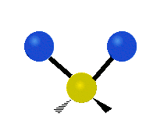
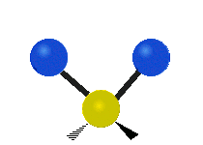
What are the possible vibrational motions?
Stretching
  Symmetric
  Asymmetric
(a) (b)

Slide 32



What are the possible vibrational motions?
Bending
c. Rocking
  d. Scissoring
  e. Wagging
  f. Twisting
(c) (d)
(e) (f)

Slide 33
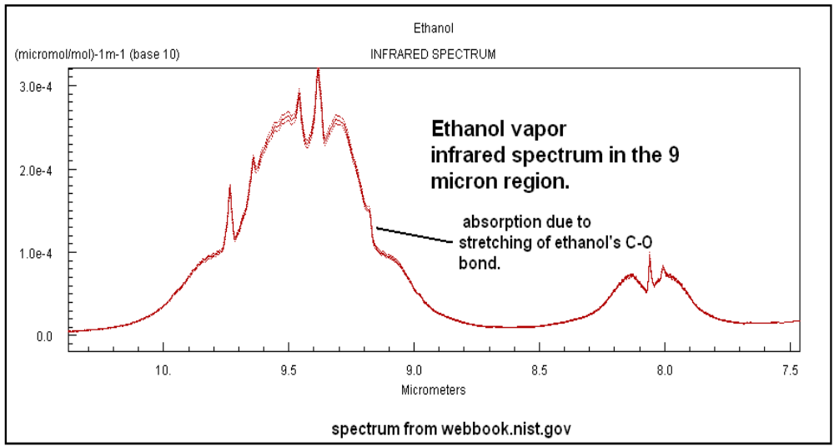
Ethanol IR Signature at 9 µ range

Slide 34
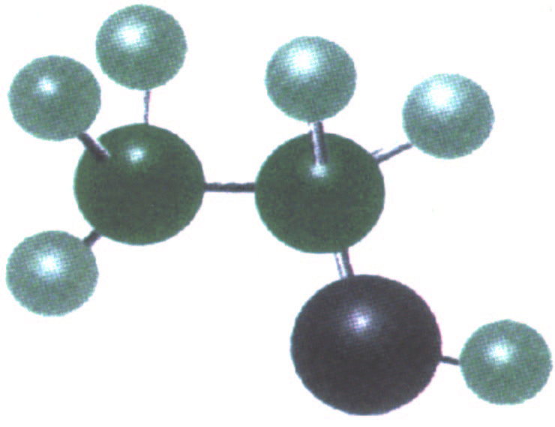
Ethanol molecule
hydrogen
Carbon
Carbon
Hydroxyl group
Methyl group
C2H5OH
oxygen
Notes:
Ethyl alcohol is an organic compound (meaning it contains carbon and hydrogen atoms). It is also a small aliphatic (likes water) hydrocarbon and a primary (hydroxyl on an end-chain carbon) alcohol. PHEW! I hope you got all of that… because it certainly isn’t going to be said again.
Ethyl alcohol and ethanol mean the same thing. In generic terms the molecule can be referred to as alcohol. In more specific terms it is in a family of chemicals called “alcohols”.

Slide 35
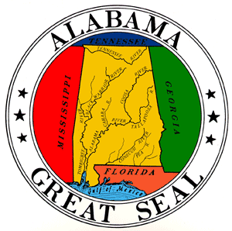

Alabama DUI Law Based on Blood Alcohol
Title 32-5A-191(a)states in part:
“A person shall not drive or be in actual physical control of a vehicle while:
(1) There is 0.08 percent or more by weight of alcohol in his or her blood;
(2) Under the influence of alcohol …”
[remainder of statute omitted]

Slide 36
Alcohol Testing in Alabama
The Chemical Test for Intoxication Act: Code of Alabama, 1975 section 32-5A-194
Section 32-5A-194(a)(5): “Percent by weight of alcohol in the blood shall be based on grams of alcohol per 100 cubic centimeters of blood or grams of alcohol per 210 liters of breath.”
The Code of Alabama allows blood to be tested directly (by use of blood testing) or indirectly (by use of breath testing).

Slide 37
Preferred Testing Method
Which method is the scientifically preferred method to determine ethanol in the bloodstream - blood or breath?
Direct testing (blood) or indirect testing (breath)?

Slide 38
Why is Breath Testing Used?
Low cost – no cost to run a test
Quick – results back in minutes
No expertise required – does not require any expertise to run a test – just push the “go” button
Non-Invasive – No blood is drawn; no entry into the body
Clean and convenient – the machine is always ready; no wait time

Slide 39
Six Points of Error in Every Breath Test
Machine Error (Measurement Error)
Breathing Pattern
Breath Temperature
Hematocrit Variability
Partition Ratio
Residual Alcohol (Mouth Alcohol)

Slide 40

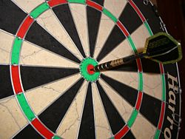

Accuracy and Precision
Accuracy is the degree of veracity while precision is the degree of reproducibility.
We want accuracy and precision in any test!

Slide 41
ADFS Calibration Test - .02 Dry Gas
DFS Reg. 370-1-1-.01: “Calibration Checks”
“A 0.020 g/210L ethanol standard is introduced into the instrument before the first subject sample is collected. An acceptable result of 0.015 to 0.025 g/210L will allow the Breath Alcohol Test to proceed.”
The calibration margin of error in every calibration check using .02% dry gas (99% pure laboratory standard) is +/- 0.005 or 4% margin of error.

Slide 42
DFS “Acceptable Result” Test -.08 Dry Gas
DFS Reg. 370-1-1-.01 “Calibration Checks"
“A 0.080 g/210L ethanol standard is introduced into the instrument after the second subject sample is collected. An acceptable result of 0.076 to 0.084 g/210L must be obtained before the results of the Breath Alcohol Test will be reported.”
The margin of error using .08% dry gas (99% pure laboratory standard) to achieve an “acceptable result” calibration test is +/- .004 or 5%.
There is a 5% margin of error in every breath test in the state of Alabama [using the Draeger 7110]

Slide 43
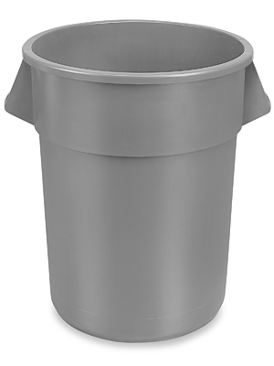
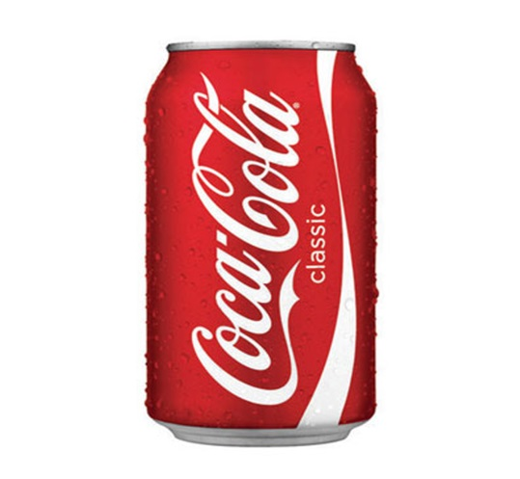
Breath Result v. Breath Actually Measured
Amount of breath measured by Draeger = 70 mL
Actual measurement approximates to:
into
1/5 of a 12 oz. (355 mL) can of Coca-Cola
55 gallon drum (210 liters)
Notes:
0.08g/210L = 0.0266 mg/70mL
0.3 mg is weight of salt grain, so 0.0266 is less than one tenth of a grain of salt.
If there was any mouth alcohol, EBA, or other interferent that the machine mistakenly called lung alcohol then this error was multiplied and compounded 3000 times causing a false high reading.

Slide 44
70 mL vs. 210 Liters
70 mL X 3000 = 210 Liters
In order for the Draeger 7110/9510 to provide a test result, the machine must multiply the reading obtained from the 70 cc chamber by 3,000.
Question? What if the initial reading taken from the sample chamber was inaccurate?

Slide 45
Breathing Patterns
The harder you blow
the higher you go

Slide 46
Properties of Ethanol
Ethanol is hydrophilic [bonds to and mixes completely with water]
“Ethanol distributes into the total body water, which compromises between 50-60% of body weight.” Garriott’s at pg. 50

Slide 47
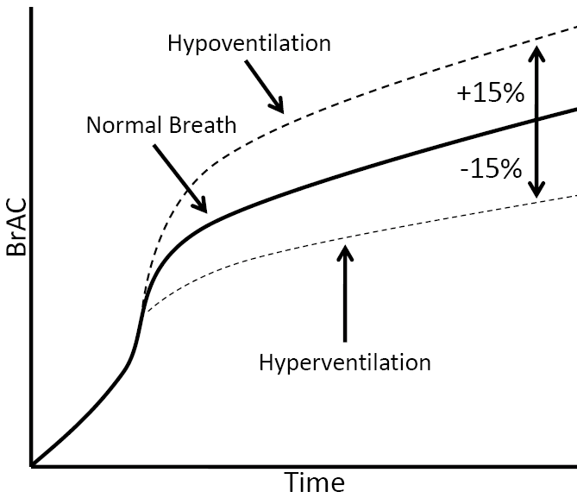
Breathing Patterns
Notes:
Hyperventilation and hypoventilation will cause as much as a ±15% variation in a breath test result. The longer a person holds his or her breath, the higher the result. Short, rapid breaths tend to flush out the lungs and result in a lower reading.

Slide 48
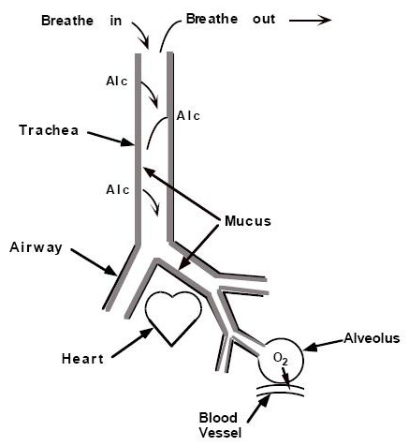
Exhaled Lung Air
During respiration deep lung alcohol is deposited in the mucus lining of the upper airway causing *EBA (extra breath alcohol) to be added to test result.
Notes:
Breath testing is based on assumed correlation of blood and breath and is premised assumption that only deep lung air is tested.
During respiration deep lung alcohol is deposited in the mucus lining of the upper airway causing *EBA (extra breath alcohol) to be added to test result.

Slide 49
Hematocrit Ratio
The hematocrit ratio measures the volume of red blood cells compared to the total blood volume (red blood cells and plasma). The normal hematocrit for men is 40 to 54%; for women it is 36 to 48%. *
A higher ratio of red blood cells to total blood volume means a lower plasma (liquid component)
* Hemoglobin and Hematocrit. Clinical Methods: The History, Physical, and Laboratory Examinations, 3rd edition (1990)Chapter 151.

Slide 50
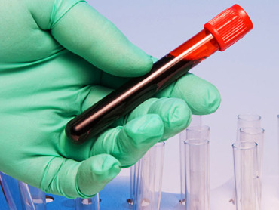
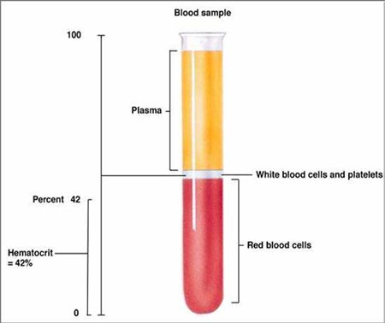
Hematocrit
Notes:
Hematocrit is a value, expressed as a ratio of the solid components of blood (cellular material) to the liquid components of blood (water).
In a normal, healthy human being, it can vary the amount of alcohol which is contained in the blood.

Slide 51
Hematocrit
Higher Hematocrit Lower Hematocrit
More Solids
Less Water
Higher Alcohol
Concentration
Less Solids
More Water
Lower Alcohol
Concentration
Notes:
With breath tests, normal variation in the hematocrit of test subjects “can produce errors in… the 10 to 14% range.”

Slide 52
Partition Ratio 2100:1
All breath testing in the USA and Canada is based on the theory there exists a standard and uniform partition ratio of 2100 parts breath air to one part blood for all persons.
Partition Ratio = Concentration of Alcohol in Breath
versus
Concentration of Alcohol in Blood

Slide 53
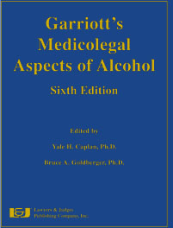
Blood-to-Breath Partition Ratios have been shown to vary from about 900:1 to about 3400:1.
Alobaidi, T.A.A., & Payne, J.P.
Significance of Variations in Blood-Breath Partition Coefficient of Alcohol
British Medical Journal, 1976
Mason, M.F. & Dubowski, K.M.
Breath Alcohol Analysis: Uses, Methods & Some Forensic Problems
Journal of Forensic Sciences 21:9-41, 1976
Yamamoto, K. & Ueda, M.
Studies on Breath Alcohol Analysis For the Estimation of Blood Alcohol Levels
Journal of Forensic Sciences 1:207-224, 1972
Medicolegal Aspects of Alcohol
Sixth Edition, James C. Garriott, Ed.
Lawyers & Judges Publishing Co.
Notes:
The State of Alabama cannot prove that Mr. Royster’s blood to breath ratio was 2100:1 nor can it be proven in fact what his ratio was on the night he was tested.
If his blood breath ratio was not 2100:1 then the State’s claim that his breath Alcohol level of 0.08 G/210L cannot be proven beyond a reasonable doubt.
The breath test result is only an estimate based on assumption that may not be true for Alicia.
According to the U.S. Government’s Center for Disease Control the average male in the United States is 5’11” and weighs 194 lbs, the average woman is 5’4” and weighs 164 lbs.
Of the people you know how many match these numbers?
The Alabama breath machine assumes we are all the same.

Slide 54
A Valuable Investment!

Slide 55
Partition Ratio Variance
Dr. Liljestrand and Linde (Sweden, 1930): Partition ratio is approximately 2000:1
Dr. Rolla Harger (USA, 1938): Partition ratio is approximately 2100:1
National Safety Council ‘Committee on Tests for Intoxication’ (USA, 1952): Partition ratio is approximately 2100:1
  Note: The “Breathalyzer” is patented in 1954 using a 2100:1 partition ratio
National Safety Council Committee Report (USA, 1974): Partition ratio should be established at 2100:1 for standardized testing
Dr. A.W. Jones (Sweden, 1978): The average partition ratio is 2055 with a deviation of +/- 120 and a range of 1794-2256
Dr. A.W. Jones (Sweden, 2002): [Simultaneous testing] The breath to blood partition ratio is variable from person to person and from test to test with a average range of 2100 - 2300, with 85% of the population in that range.

Slide 56
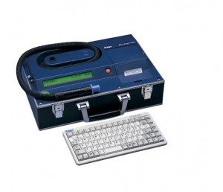
Partition Ratio Variability
Corrected BrAC
2300:1
.08 (.087)
.08 BrAC
Result
2100:1
.08 (.080)
2000:1
.07 (.076)
1794:1
.06 (.068)

Slide 57
End of Materials
What Are Your Questions?
Law Office of Patrick Mahaney
8191 Seaton Place
Montgomery, Alabama 36116
www.mahaneylaw.com

